Slide 1
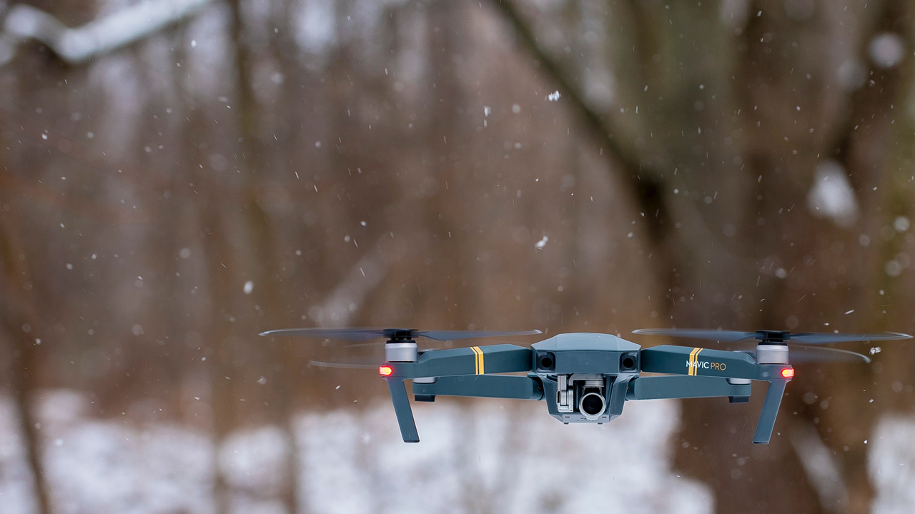





Stationary LIDAR Sensors for Indoor Quadcopter Localization
Marcell Rausch, Gabor Feher
Department of Telecommunication and Media Informatics
Budapest University of Technology and Economics High Speed Network Laboratory, Budapest, Hungary
2020.09.21
Notes:
Good morning, afternoon or night, depending on where you are watching this conference from.
I’m Marcell Rausch, the main author of this paper and I would like to present you my work on Stationary LIDAR sensors for indoor quadcopter localization.
A co-author of this paper is my professor at Budapest university of technology and economics: Gabor Feher

Slide 2
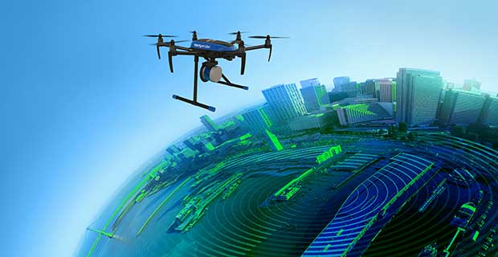
SLAM algorithm and LIDAR scanner
Simultaneous Localization and Mapping
Uses camera or distance measurements as an input
LIDAR – light-based ranging device
Planar scanners for 2D or 3D scanning → Mechanical component
Stationary LIDAR sensors, no moving parts
Notes:
Any vehicle that is desired to be driven autonomously needs information of its position and environment to be able to navigate. In cases where no external infrastructure is available, it is common to use a method called SLAM.
To give you a bit of background, SLAM stands for Simultaneous localization and mapping and it is a collective name for algorithms that are used to localize a robot or other vehicle in an unknown environment. While also creating a map of this unknown environment.
The main input of SLAM comes from a ranging device that is typically light-based. Typically a camera or a LIDAR, but I have mainly focused on LIDARS. A LIDAR can measure distance to a single or to a set of points at a time and by rotating them using a servo motor, these measurement points can be extended to 2D or even 3D. Rotating LIDAR sensors are called Planar scanners, that are precise instruments and can be used to produce highly detailed maps, but require an industrial grade hexa or octacopter to be carried airborne.
My idea is to develop a system that uses well-placed stationary LIDAR sensors to scan the environment of a small quadcopter under 1kg. And build a map using data coming from this system.
This can be useful in scenarios where mapping or localization is needed, but mapping quality is less important.

Slide 3
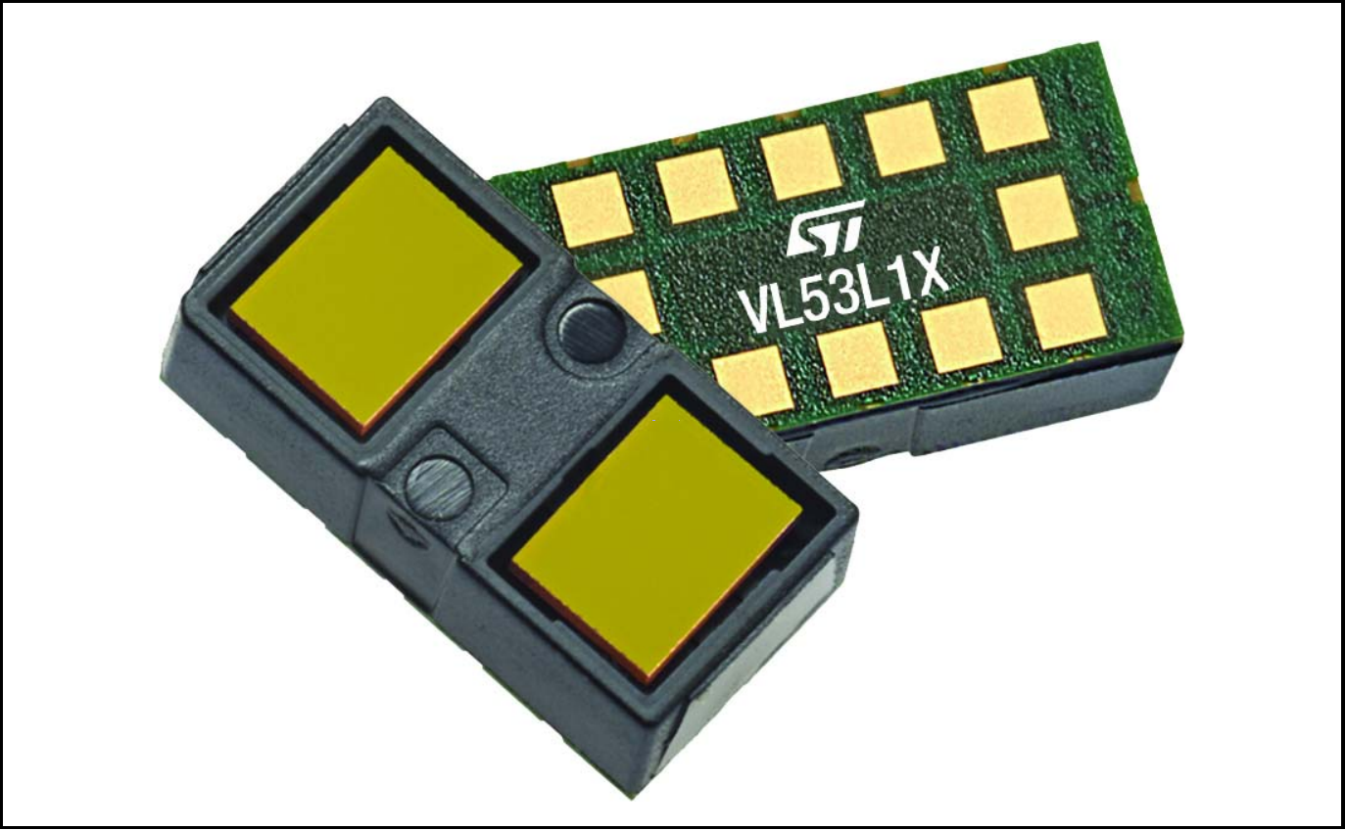
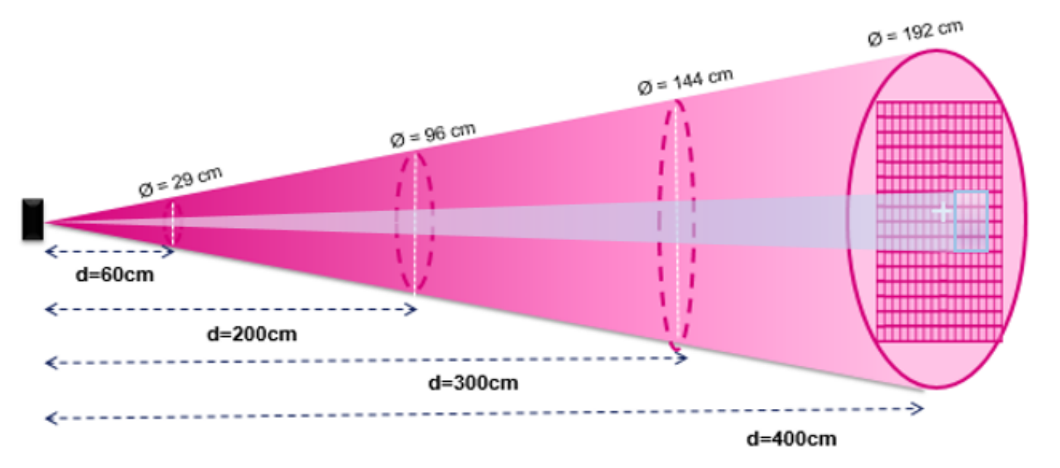
VL53L1X LIDAR sensor
Features:
Size: 4.9x2.5x1.56mm
Weight: 0.5g
4m maximum range
50Hz maximum sampling rate
Adjustable Region of Interest
27° Field-of-view
RoI
Extend resolution 1D->2D
Move RoI to scan the FoV
2x2, 3x3, 4x4
FoV
*This project was not sponsored in any way by STMicroelectronics
Notes:
My choice was VL53L1X LIDAR sensor produced by STMicroelectronics, because of previous experience and it was the smallest and lightest sensor on the market in its field.
It weighs only half a gram and can measure up to 4m and up to 50Hz sampling rate. Its most relevant feature for this project is that it has an adjustable Region of interest.
In other words, a region in the sensor’s field of view can be selected, and distance will be measured to an object in this region.
By dividing the field of view into even non-overlapping regions and measuring distance in them one after another, a higher resolution image can be acquired from the sensor.
I call this scanning.
Using this method I was able to extend this single point LIDAR sensor to produce a 2D array of ranges, with a resolution of 2x2, 3x3 or 4x4.

Slide 4
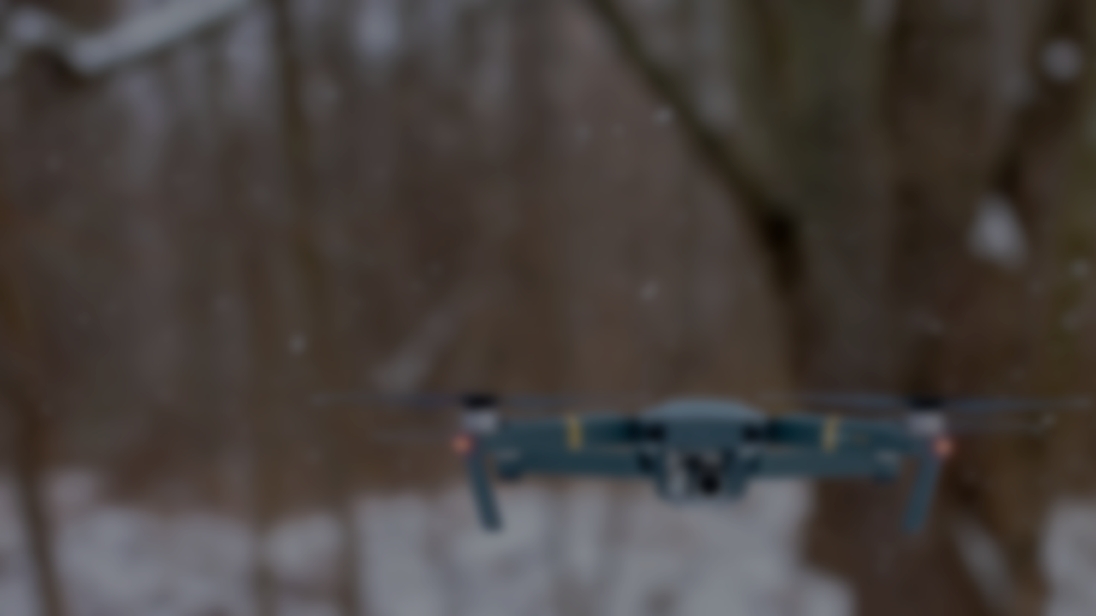
Measurements using VL53L1X
Extracted parameters
Maximum distance
Standard deviation
Sampling rate
Sensor settings
Timing budget
Distance preset
Resolution
Accurate sensor simulation
Notes:
Because of COVID-19, this concept was verified using simulations.
But to simulate the selected LIDAR sensor accurately, I have conducted a series of measurements with every relevant sensor setting configuration.
A sensor has the following settings:
The timing budget is an analog value, that sets the maximum time available for the sensor to complete the ranging procedure.
Distance preset sets the internal thresholds for short, medium or long ranging
The Resolution is the image resolution as described before.
The measurements have been repeated on the same set of distances with every relevant sensor setting combination.
And I have determined the following parameters: Maximum ranging distance, Standard deviation and sampling rate of the complete scan.
Using these extracted parameters, the LIDAR with these setting configurations can be accurately simulated.

Slide 5
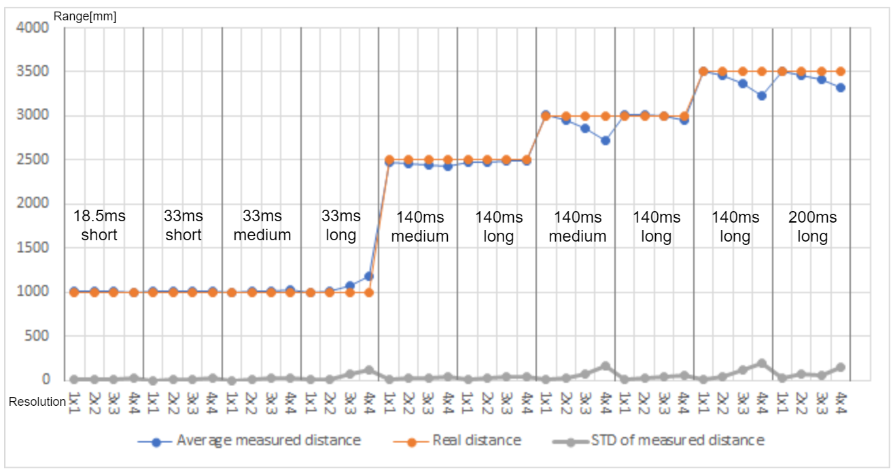
Measurements using VL53L1X
Notes:
Here you can see the results of the conducted measurements on a single plot. The Y axis shows the average ranging distance in mm, while x axis represents the sensor resolution grouped by sensor settings.
In each column a group of measurements are plotted using the same distance preset short, medium or long and the same timing budget on every resolution. This is to see how resolution affects the ranging distance and standard deviation, while keeping the other settings untouched.
For each point on this figure, measurements were collected for at least 1 minute. Ranging distance and standard deviation is determined by averaging this dataset.
You could see that ranges start to deviate from the real distance, if it is increased above a certain level. I have determined the maximum distance as the farthest distance without deviation.

Slide 6
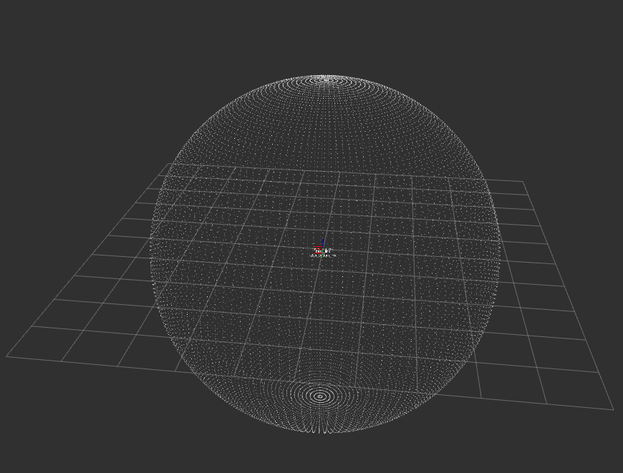
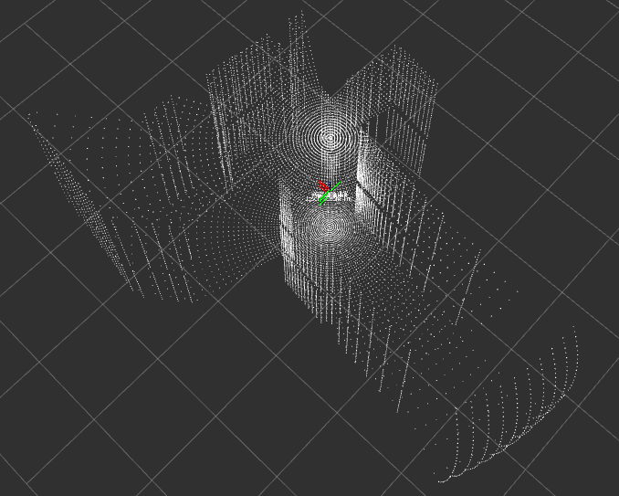
Data collection in Gazebo simulator
Inputs: LIDAR scan and IMU
2D and 3D online SLAM
Used by Google street view
Great community
Available as ROS package
Notes:
Data collection has been done in Gazebo simulator using the PX4 repository for the simulation of the drone. I have placed 2 LIDAR sensors on the simulated quadcopter, each scanning the top and bottom hemispheres of the environment of the vehicle. A complete, saturated scan can be seen in the left image and a scan inside a building in the right.
This is done to have a complete, high-resolution and high-sampling rate scan, that can be filtered later, to match the LIDAR parameters and layout.
Using this method, the same data collected during a flight can be used to simulate different sensor settings and layouts, and their performance can be compared.

Slide 7
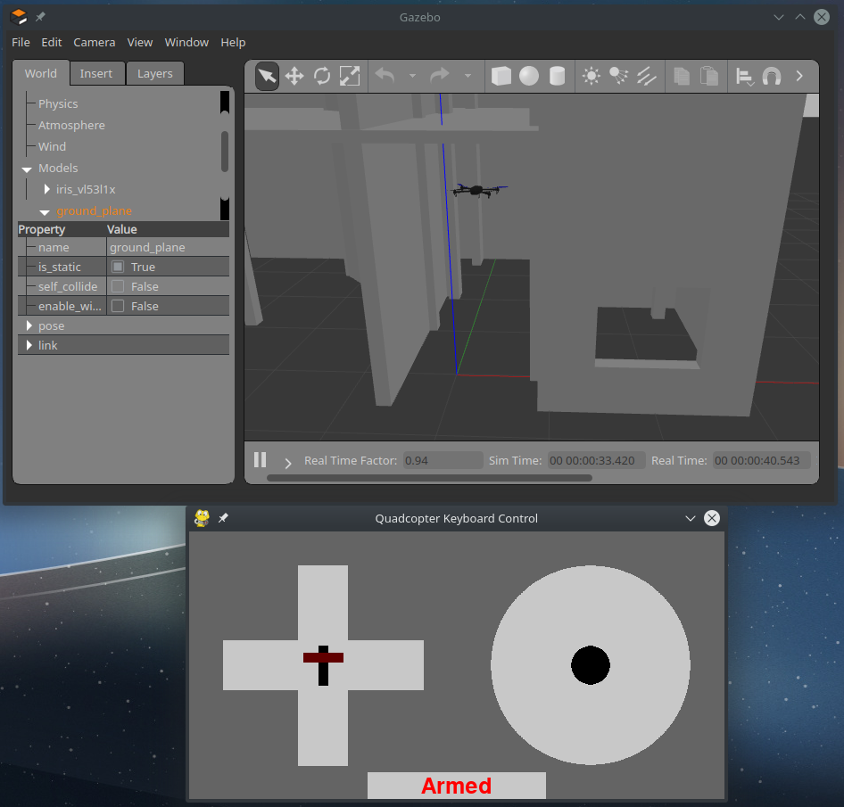
Data collection in Gazebo simulator
Collected data
LIDAR – 4m, 50Hz
IMU – 50Hz
Absolute position
Transformations
Notes:
He following data is collected from the simulator:
LIDAR, IMU, Absolute position published by Gazebo and transformations that contain the sensor positions in relation to the main vehicle frame.

Slide 8
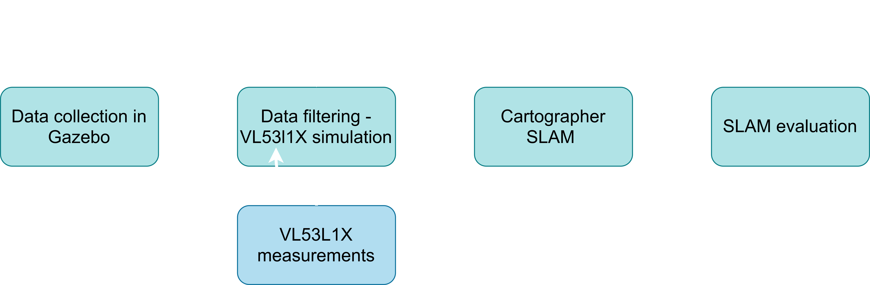
2D SLAM evaluation - workflow
Raw data filter
Sensor layout
Sensor parameters
Resolution
Sampling rate
Maximum distance
Trajectory evaluation
Absolute measure
RMS error
Ground-truth trajectory
SLAM trajectory
Notes:
After collecting data from Gazebo simulator, the next step is to filter it to match a certain sensor layout and settings. This is done by a custom python script, that sets the number of sensors, layout and the previously determined parameters, that are the same for each sensor in the layout.
As for processing, I chose Cartographer SLAM, because of its popularity. The SLAM algorithm needs to be tuned every time to provide the most accurate map and localization. The tuning procedure requires patience and experience; therefore it is subject to human error.
As the last step of the workflow, to be able to compare different SLAM setups, an objective measure is needed. For this I chose to calculate the RMS error between the SLAM trajectory and the trajectory extracted from the raw data, produced by Gazebo. The smaller this error is, the closer the estimated trajectory follows the ground-truth.

Slide 9
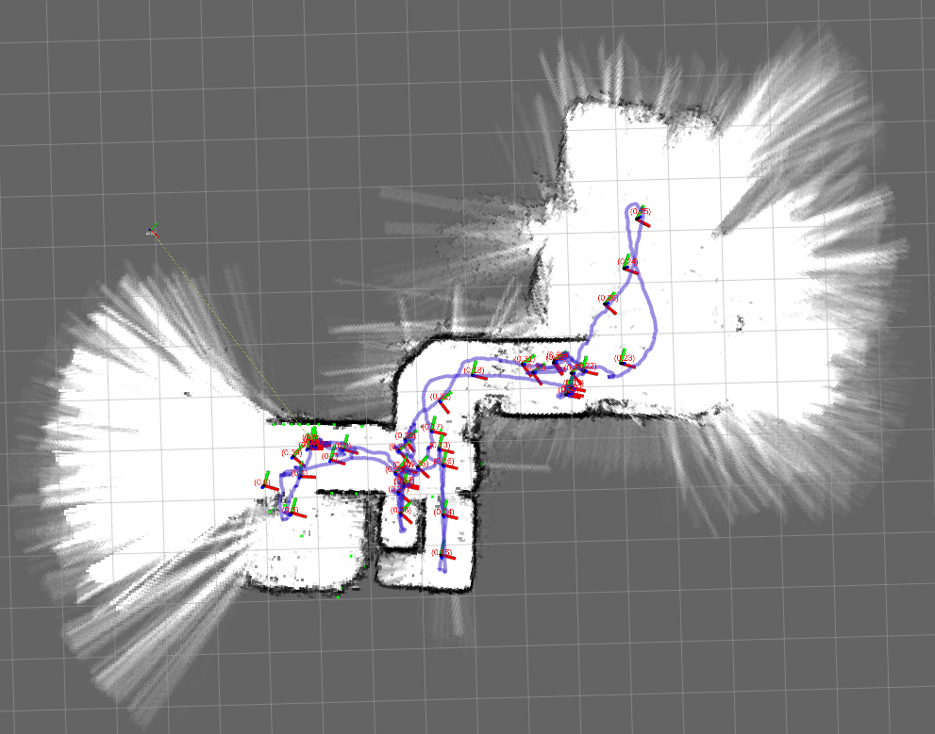
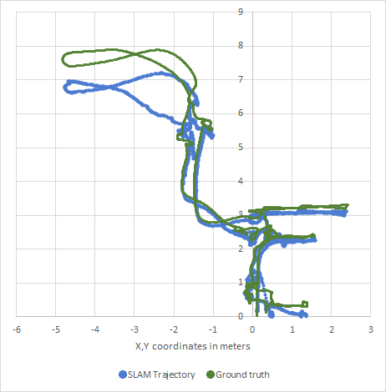
SLAM setup evaluation
1.Visual inspection of produced map
Submap consistency and quality
Global map consistency
2. RMS error calculation of SLAM trajectory
Against ground truth trajectory
Objective measure
Notes:
The SLAM evaluation starts with a visual inspection during the tuning of Cartographer SLAM. Here I have focused on the consistency and quality of the built map, but also on the reliability of the procedure.
The second step is the RMS error calculation between the ground-truth and the SLAM trajectory. For this, an example can be seen on the right, extracted from the map on the left.

Slide 10
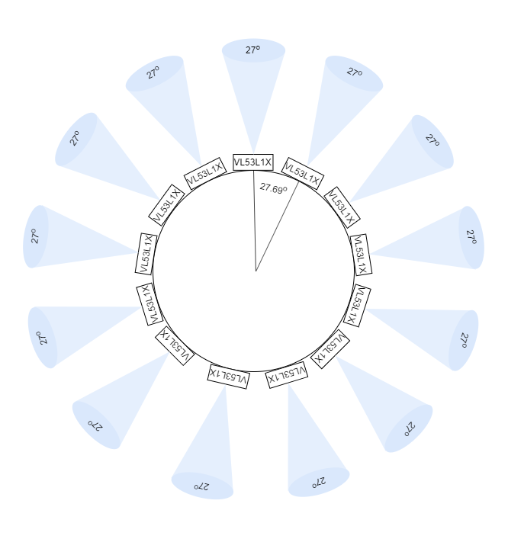
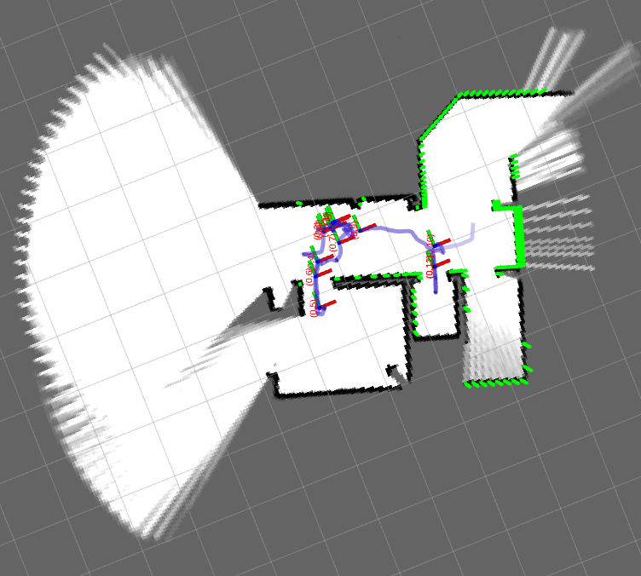
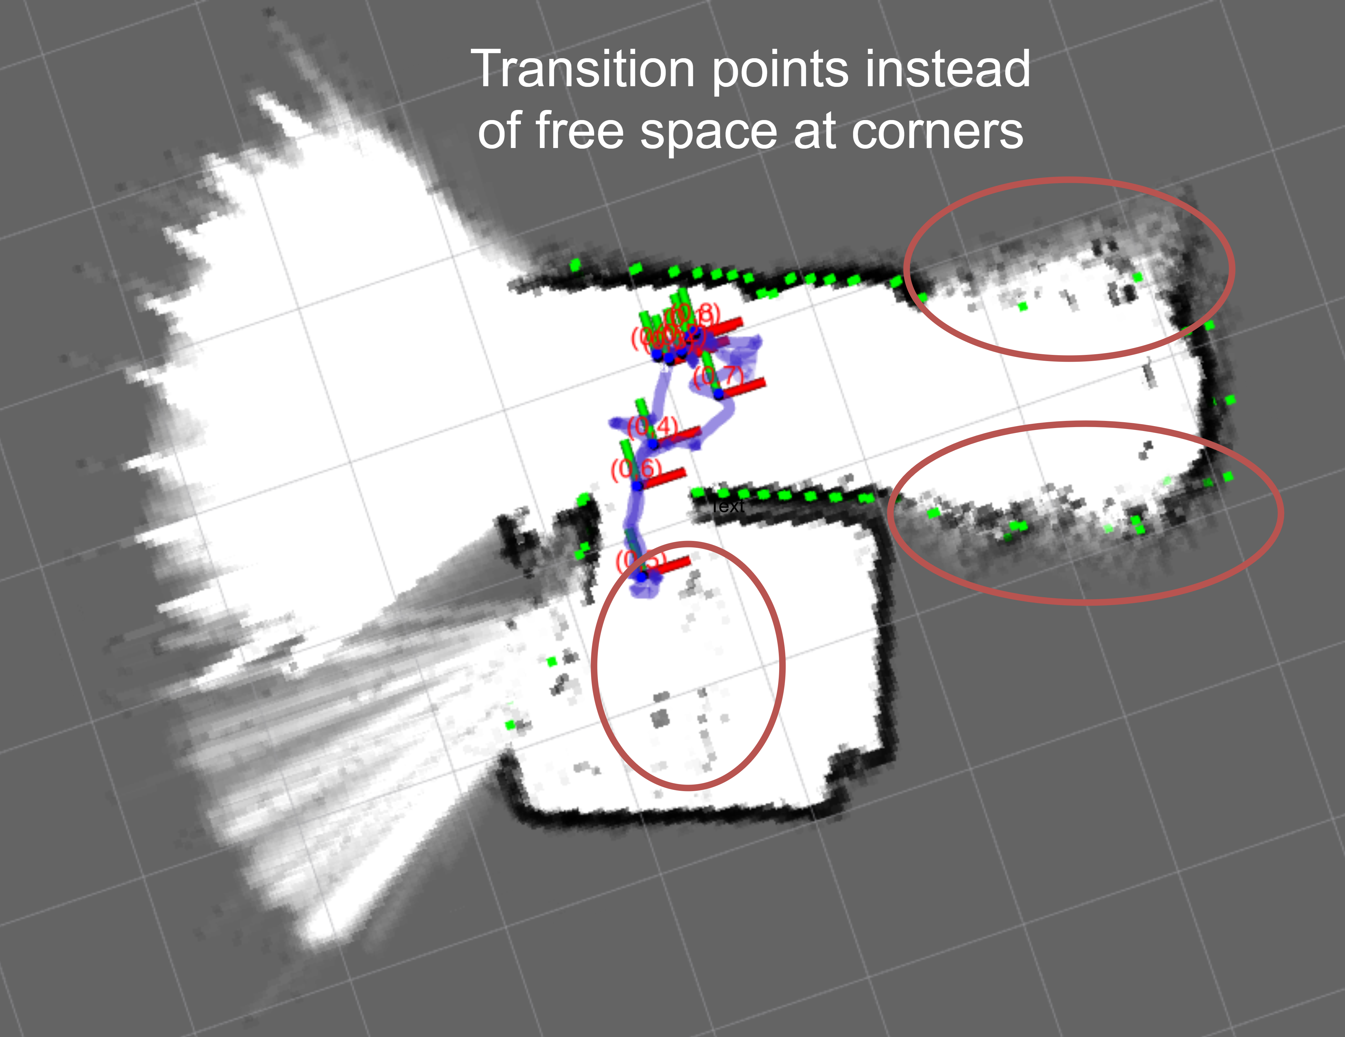
Sensor settings introduction
Even layout in 2D using 13 sensors
LIDAR resolution
Artifacts on map
Transition points
Curved corners
Sampling rate
SLAM requires precise tuning
Maximum distance
Reduces the number of valid measurements in bigger rooms
SLAM is less reliable
Notes:
I wanted to be able to differentiate the errors caused by different sensor parameters, so I chose to introduce them one-by-one, instead of just enabling all at once. For this, the same layout has been used, consisting of 13 sensors, with non-overlapping field of views, covering 360 degrees of the horizontal plane.
Sensor resolution is expected to have the highest impact, then the sampling rate and lastly the maximum distance. So they were introduced in this order.
At first, I tried the effects of 4x4 resolution without changing other parameters and step-by-step went down to lower sensor resolutions. Lower resolutions mean higher sampling rates, but my experience is that the number of points per scan is more important, than the sampling rate.
Lower resolutions introduced artifacts like curved corners and what I call transition points. These points are inserted into a map, when near and far objects are visible inside the sensor’s field of view, so the range point is placed somewhere in between.
Sampling rate made the tuning procedure harder, because it required different parameters to be tuned, but it did not introduce artifacts.
Maximum distance has proved to have a high impact on the reliability of the map building, because it saturates a high number of ranges per scan, that are excluded from the SLAM procedure.
This reduced set of points are inserted into the current map less effectively and sometimes caused the map to fall apart without proper tuning.

Slide 11
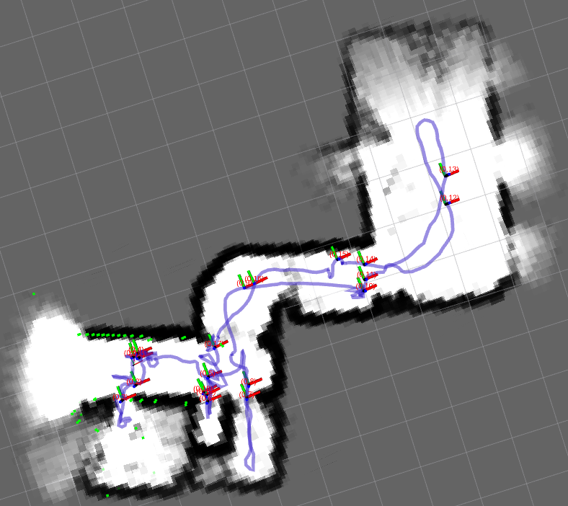
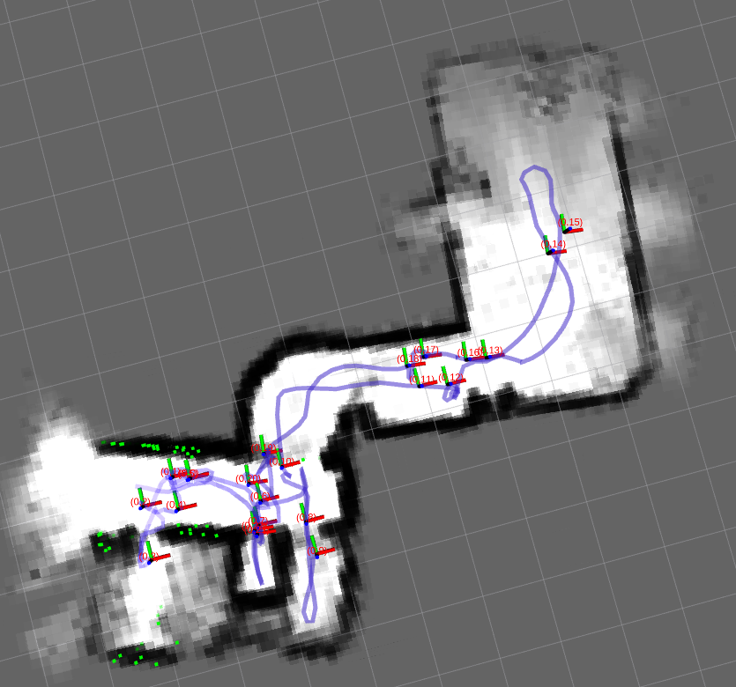
Reduced set of sensors
13 sensors
Removed sensors from the previous set until the built map is still consistent
→ 8 sensors proved to be the lowest number of sensors in even layout
Introduced setting | Resolution | RMS error
Unfiltered | - | 6.95cm
Resolution | 3x3 | 8.34cm
Sampling rate (400ms) | 4x4 | 16.49cm
Max distance (275cm) | 4x4 | 35.12cm
Reduced number (8p) | 4x4 | 34.1cm
8 sensors
Notes:
Lastly, I wanted to reduce the number of sensors to see how it affects the mapping quality and to find the lowest number of sensors needed for the map building.
So I have removed sensors one-by-one until the produced map is still consistent and map building is reliable. I have found 8 sensors to be the lowest number to produce maps like that.
A Map built using 13 sensors can be seen in the top image and using 8 in the bottom. A slight Tilt can be observed in the big room using the reduced set of sensors and some opacity on the bottom left.
A summary of the RMS error can be seen in the table at the bottom, showing that the unfiltered data has 6.95cm error, while the introduction of the sensor resolution only raised the error by 1.4cm.
On the other hand, the introduction of Sampling rate doubled, and the maximum distance almost quadrupled this error. The reduction of the number of sensors from 13 to 8 apparently reduced the error,
but I think it’s because of finer tuning.

Slide 12
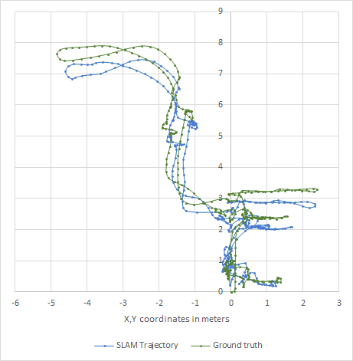
Conclusion
A navigation system
Lightweight
Stationary LIDAR sensors
Without mechanical components
8 sensors minimum
13 sensors for better quality
Produce decent quality maps in smaller buildings
SLAM Trajectory using 8 LIDAR sensors
Notes:
In this paper, I have presented you a navigation system that is lightweight so it can be used on quadcopters under 1kg, and only uses stationary LIDAR sensors without mechanical components. A minimal 8 sensors need to be used, or 13 for better mapping quality. This system is able to produce decent quality maps for navigation inside smaller buildings.

Slide 13
Thank you for your attention!
Notes:
Thank you for your attention! And I would like to say a very special thank you to my wife, who supported me throughout my work. Without her it would not have been possible. If you have any questions, I’m happy to answer them!

